Slide 1
PROYEK PERANGKAT LUNAK 08. Manajemen Waktu Proyek
Doni Abdul Fatah h
github.com/doniaft
Universitas Trunojoyo Madura

Slide 2
Pokok Bahasan
01. Pengantar Manajemen Proyek Perangkat Lunak
02. Siklus hidup Proyek
05. Analisa Proyek
03. Organisasi Proyek
04. Perencanaan Proyek
07. Penentuan Proyek
06. Desain Proyek
08. Manajemen Waktu Proyek
10. Manajemen SDM Proyek
11. Manajemen Risiko Proyek
09. Manajemen Biaya Proyek
12. Monitoring & Penutupan Proyek
13. UAS

Slide 3
01. PPL
Perencanaan Proyek
Kontrak Perkuliahan

Slide 4
2) Siklus hidup Proyek

Slide 5
Proyek Siklus hidup PPL
Analisa kebutuhan
Spesifikasi
Disain
Coding
Verifikasi dan validasi
Implementasi / Instalasi
Maintenance dan support

Slide 6
Project Planning

Slide 7
Recap
The systems analyst is a key person analyzing the business, identifying opportunities (peluang) for improvement, and designing information systems to implement these ideas
The Systems Development Lifecycle consists of four stages: Planning, Analysis, Design, and Implementation
The major development methodologies:
Structured Design /penggambaran model sistem/modeling
Waterfall method
Parallel development
Rapid Application Development/ proses pembuaan lebih cepat/singkat,bertingkat/framwork
Phased Development
Prototyping
Throw-away Prototyping
Agile Development / memuaskan klien proses cepat, ringan, bebas bergerak,tim work banyak
Extreme Programming (menyederhanakan SDLC)
Scrum (kekuatan kolaborasi tim)

Slide 8
System Development Life Cycle (SDLC)
siklus pengembangan sistem
berfungsi untuk menggambarkan tahapan-tahapan utama dan langkah-langkah dari setiap tahapan yang secara garis besar terbagi dalam empat kegiatan utama, yaitu initiation, analysis, design dan implementation
SDLC didefinisikan oleh Departemen Kehakiman AS proses pengembangan software yang digunakan oleh analyst system, untuk mengembangkan sebuah sistem informasi.
SDLC mencakup kebutuhan (requirement), validasi, pelatihan, kepemilikan (user ownership) sebuah sistem informasi yang diperoleh melalui investigasi, analisis, desain, implementasi, dan perawatan software.

Slide 9
Tahapan System Development Life Cycle (SDLC)
System initiation ialah perencanaan awal untuk sebuah proyek guna mendefinisikan lingkup, tujuan, jadwal dan anggaran bisnis awal yang diperlukan untuk memecahkan masalah atau kesempatan yang direpresentasikan oleh proyek.
System analysis ialah studi domain masalah bisnis untuk merekomendasikan perbaikan dan menspesifikasikan persyaratan dan prioritas bisnis untuk solusi.
System design ialah spesifikasi atau konstruksi solusi yang teknis dan berbasis komputer untuk persyaratan bisnis yang diidentifikasikan dalam analisis sistem.
System implementation ialah konstruksi, instalasi, pengujian dan pengiriman sistem ke dalam produksi (artinya operasi sehari-hari).

Slide 10
Tahapan Pengembangan Software
Planning
Design
Implementation
Analysis

Slide 11
Distribusi Cost Pengembangan Software

Slide 12
2. Project Planning
2.1 Identifying Business Value (System Request)/permintaan
2.2 Feasibility Analysis/kelayakan
2.3 Project Size Estimation/ukuran suatu project/ membandingkan
Sumber :
Romi Satria Wahono romi@romisatriawahono.net http://romisatriawahono.net/sad

Slide 13
When Do Projects Begin?
When someone sees an opportunity (kesempatan) to create business value (nilai bisnis) from using information technology
Then he or she creates a system request
Feasibility analysis (kelayakan) is used to aid in the decision (pengambilan keputusan) of whether or not to proceed with the project (layak/tidak)
Project estimation is important (penting) activity which aims (tujuan) to estimating the size of software project

Slide 14
Software Development Life Cycle (SDLC)
Planning: Why build the system?
System request, feasibility analysis (sistem permintaan, analisis kelayakan)
Analysis: Who, what, when, where will the system be?
Requirement gathering, business process modeling
Design: How will the system work?
Program design, user interface design, data design
Implementation: System construction and delivery
System construction, testing, documentation and installation

Slide 15
Planning
Identifying business value
Lower costs (biaya rendah)
Increase profits (keuntungan bertambah)
Analyze feasibility (kelayakan)
Technical Feasibility
Economic Feasibility
Organizational Feasibility
System Proposal

Slide 16
Elements of a System Request
Project Name
The name of project
Project sponsor
Primary point of contact for the project
Business need/kebutuhan
Reason (alasan) prompting the project
Business requirements/persyaratan/featurnya
Business capabilities the system will need to have (kemanpuan sistem)
Business value/nilai tambah
Benefits the organization can expect from the project (manfaat)
Special issues
Anything else that should be considered(hal2 yg jadi pertimbangan)
Budget constraints, deadline, Legal requirements

Slide 17
Business Need/Kebutuhan Bisnis
Describes why the system should be built (kenapa sistem dibangun)
Why the project should be funded/ (kenapa sistem didanai)
Should be clear and concise (jelas & Ringkas)
Probably not completely defined

Slide 18
Business Requirements / Mau nya apa
What the system will do (sistem bisa apa?)
High level explanation to the approval committee
Tell about the features and capabilities
Can be replaced by Use Case Diagram

Slide 19
Business Value
Tangible value /nilai yang dapat di ukur
A quantifiable value
E.g.: 2 % reduction in operating cost
Intangible value/nilai tidak berwujud
Intuitive believe why the system will help the company (membantu perusahaan)
E.g.: improved customer service, a better competitive position

Slide 20
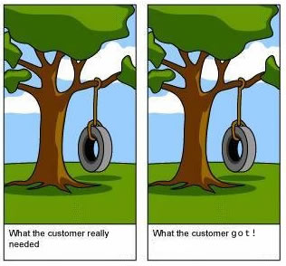
Sofware Quality
Software quality is (IEEE, 1991):
The degree (sejauh mana) to which a system, component, or process meets specified requirements
The degree to which a system, component, or process meets customer or user needs or expectations
Software quality measures how well software is designed (quality of design), and how well the software conforms to that design (quality of conformance) (Seberapa baik perangkat lunak dirancang dan sesuai desain/kualitas) (Pressman, 2014)
Quality means (sesuai) conformance to requirements (Crosby, 1979)

Slide 21
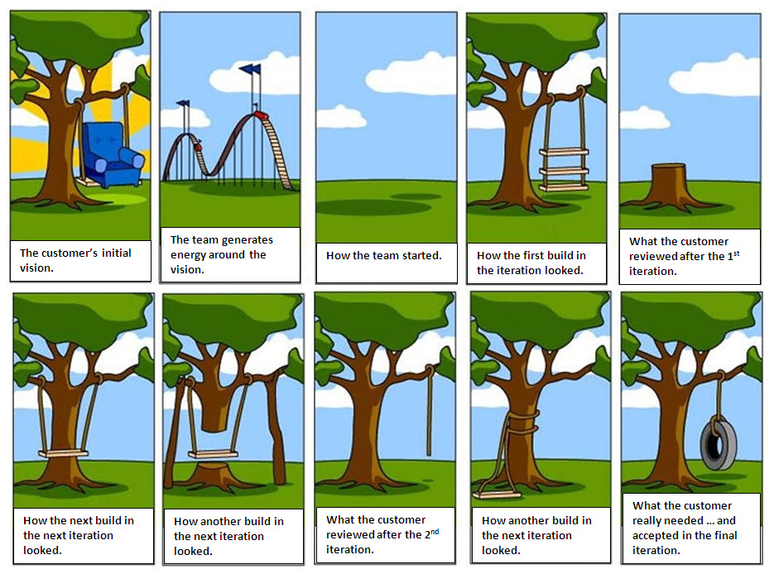

Slide 22
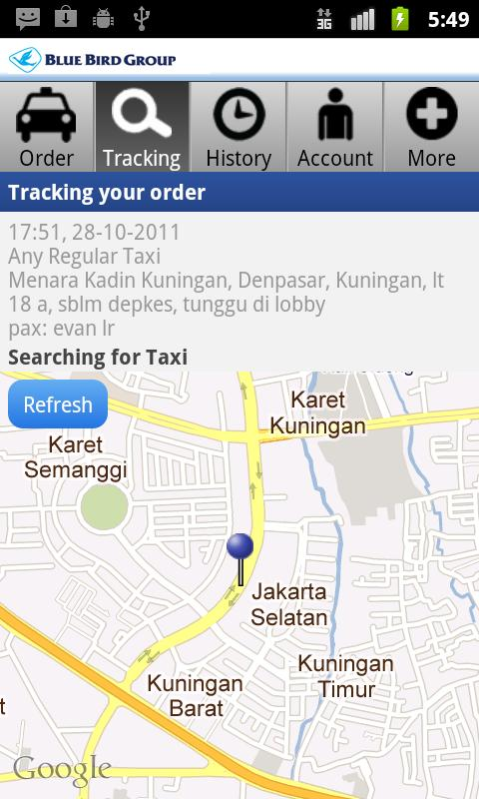
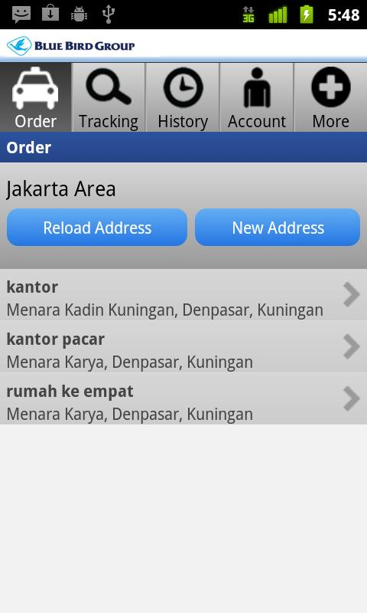
Software untuk Pesan Taxi

Slide 23
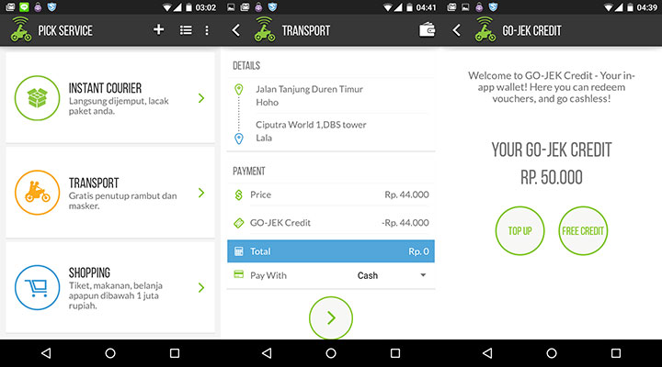
Software untuk Pesan Ojek (Go-Jek)

Slide 24

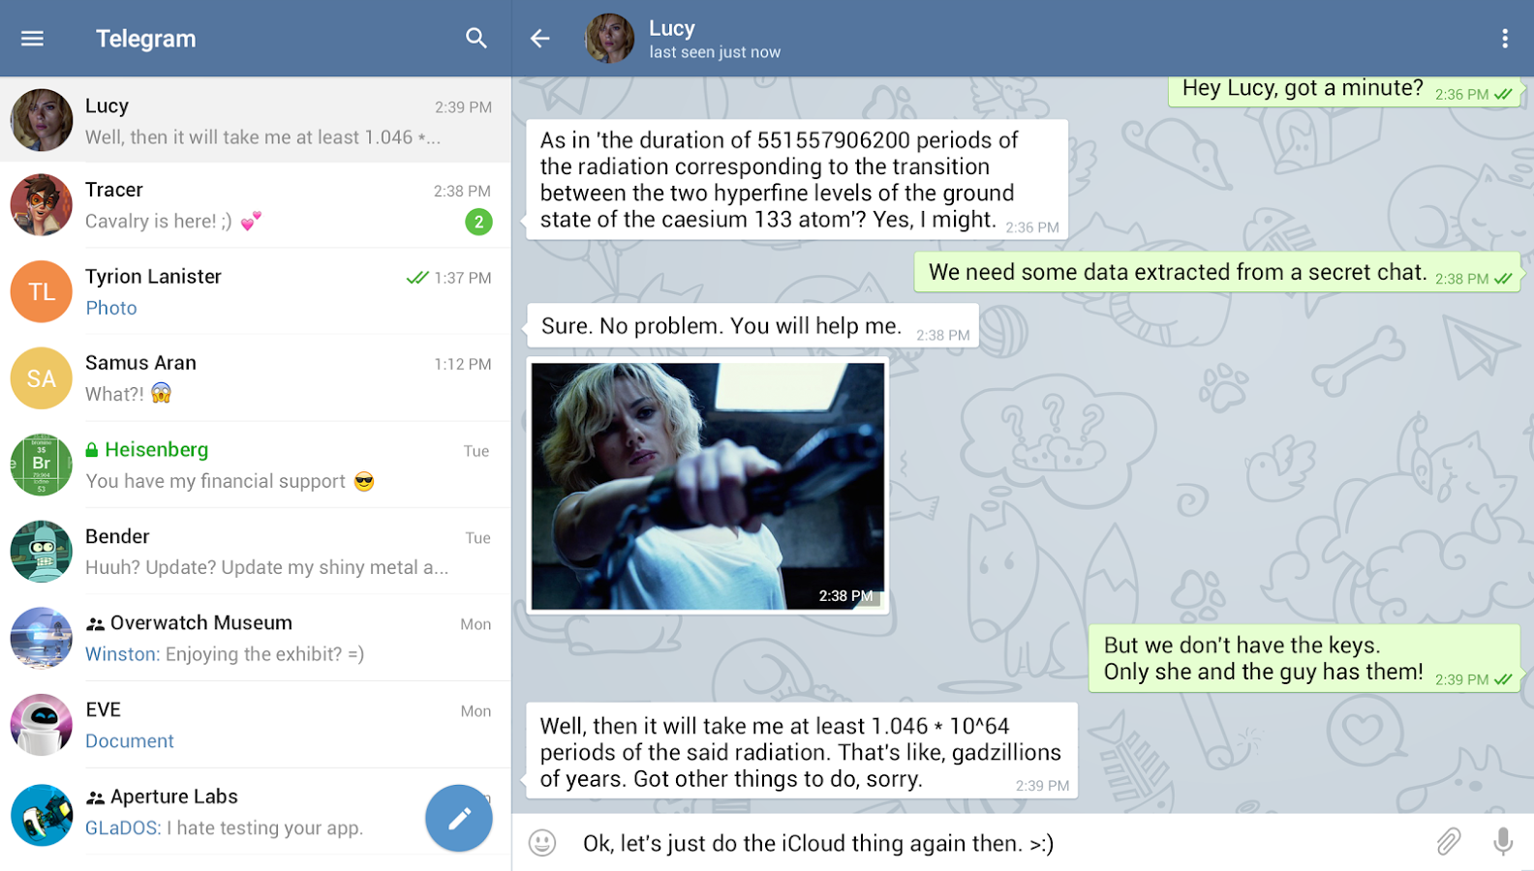

Slide 25
1. Planning – System Request
Elemen | Deskripsi | Contoh
Business Need Kebutuhan Bisnis | The business-related reason for initiating the software development project Alasan memulai proyek | Increase sales Improve market share Improve access to information Improve customer service Decrease product defects (Kurangi cacat produk) Streamline (Merampingkan) supply acquisition processes
Business Requirements Persyaratan Bisnis | The business capabilities that software will provide Kemampuan disediakan oleh perangkat lunak | Provide onIine access to information Capture customer demographic information Include product search capabilities Produce management reports Include online user support
Business Value Nilai bisnis | The benefits that the software will create for the organization Manfaat dibuat perangkat lunak | 3% increase in sales % increase in market share 10% operational cost reduction $200,000 cost savings from decreased supply costs $150,000 savings from removal of existing system

Slide 26
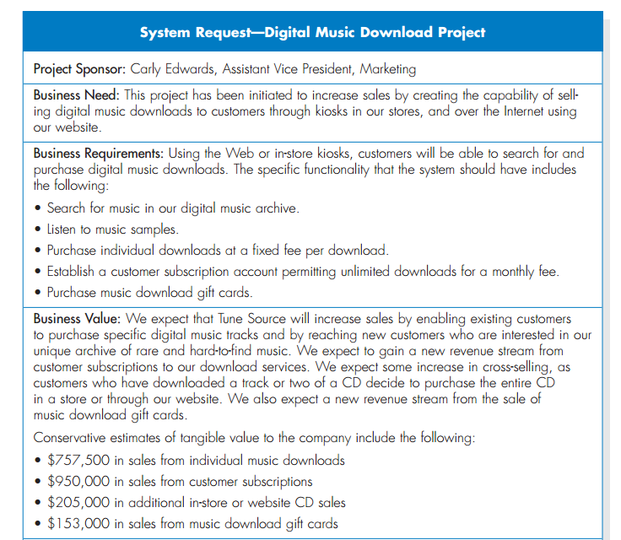

Slide 27
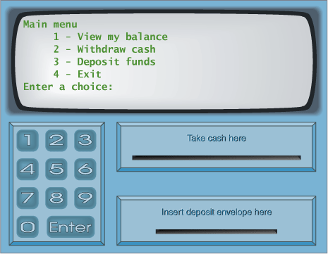
System Request – Case Study
Menu Utama
Melihat Saldo
Mentransfer Uang
Mengambil Uang
Logout
Kotak Uang
Kotak Kartu
Kotak Kuitansi

Slide 28
System Request – Online ATM System
Project Sponsor: | Margaret Mooney, Vice President of Marketing
Business Need: | Project ini dibuat dengan tujuan untuk mendapatkan pelanggan baru yang menggunakan Internet dam memberikan layanan yang lebih baik ke pelanggan yang ada melalui layanan berbasis Internet
Business Requirements:
Dengan menggunakan Online ATM System, pelanggan dapat melakukan seluruh transaksi perbankan. Fitur utama yang ada pada sistem ini adalah: Pengecekan Saldo Pengiriman Uang Transaksi Pembayaran Tagihan
Business Value:
Keuntungan Intangible: - Meningkatkan layanan ke pelanggan - Mengurangi komplen dari pelanggan Keuntungan Tangible: - $750,000 transaksi keuangan dari pelangan baru - $1,875,000 transaksi keuangan dari pelanggan lama - $50,000 pengurangan biaya telepon untuk melayani pelanggan

Slide 29
System Request: CD Selection Project
Project Sponsor: | Margaret Mooney, Vice President of Marketing
Business Needs: | This project has been initiated to reach new Internet customers and to better serve existing customers using Internet sales support
Business Requirements:
Using the Web, customers should be able to search for products and identify the brick-and-mortar stores that have them in stock. They should be able to put items on hold at a store location or place an order for items that are not carried or not in stock. The functionality that the system should have is listed below: Search through the CD Selections’ inventory of products Identify the retail stores that have the product in stock Put a product on hold at a retail store and schedule a time to pick up the product Place an order for products not currently in stock or not carried by CD Selections Receive confirmation that an order can be placed and when it will be in stock
Business Value:
Intangible Value: Improve customer satisfaction Increase brand recognition due to its Internet presence Tangible Value: Increase sales by reducing lost sales due to out-of-stock or nonstocked items and by reaching out to new customers through its Internet presence $750,000 in increased sales from new customers $1,875,000 in increased sales from existing customers Reduce customer complaints, primarily because 50 percent of all customer complaints stem from out of stocks or nonstocked items $50,000 yearly reduction in customer service calls

Slide 30
System Request: CD Selection Project
Project Sponsor: | Margaret Mooney, Vice President of Marketing
Business Needs: | This project has been initiated to reach new Internet customers and to better serve existing customers using Internet sales support.
Business Requirements:
Using the Web, customers should be able to search for products and identify the brick-and-mortar stores that have them in stock. They should be able to put items on hold at a store location or place an order for items that are not carried or not in stock. The functionality that the system should have is listed below: Search through the CD Selections’ inventory of products Identify the retail stores that have the product in stock Put a product on hold at a retail store and schedule a time to pick up the product Place an order for products not currently in stock or not carried by CD Selections Receive confirmation that an order can be placed and when it will be in stock
Business Value:
Intangible Value: CD Selections should benefit from improved customer satisfaction and increased brand recognition due to its Internet presence. Tangible Value: CD Selections will increase sales by reducing lost sales due to out-of-stock or nonstocked items and by reaching out to new customers through its Internet presence. Then the improved services will reduce customer complaints, primarily because 50 percent of all customer complaints stem from out of stocks or nonstocked items. Tangible value estimation: $750,000 in increased sales from new customers $1,875,000 in increased sales from existing customers $50,000 yearly reduction in customer service calls
Special Issues or Constraints:
The Marketing Department views this as a strategic system. This Internet system will add value to our current business model. In the future, CD Selections may want to sell products directly over the Internet. The system should be in place for the holiday shopping season next year.

Slide 31
Exercise: Membuat System Request
Lihat contoh System Request pada slide sebelumnya.
Pikirkan suatu sistem* yang saat ini dibutuhkan oleh perusahaan atau organisasi anda
Buat System Request dari sistem tersebut
Pikirkan baik-baik, keuntungan yang didapat (business value) dari penerapan system tersebut di organisasi
* System request yang anda buat akan menjadi studi kasus dari pembelajaran kita selama course berlangsung

Slide 32
2. Planning - Feasibility Analysis (Analisis Kelayakan)
Technical feasibility: Can we build it?
Bisakah kita membangunnya?
Economic feasibility: Should we build it?
Haruskah kita membangunnya?
Organizational feasibility: If we build it, will they come?
Jika kita membangunnya, akankah mereka datang?

Slide 33
2. Planning - Feasibility Analysis
1 | Technical Feasibility | Familiarity with application: Less familiarity generates more risk (Kurang keakraban lebih banyak risiko) Familiarity with technology: Less familiarity generates more risk Project size: Large projects have more risk Compatibility: The harder it is to integrate the system with the company’s existing technology, the higher the risk will be (kesulitan mengintegrasikan sistem ke teknologi)
2 | Economic Feasibility | Return on Investment (ROI) Break Even Point (BEP) - titik impas jumlah pendapatan dan biaya sama atau seimbang Intangible Benefit
3 | Organizational Feasibility | Is the software project strategically aligned with the business? (Apakah proyek sesuai dg strategis bisnis)

Slide 34
Feasibility Analysis - Technical Feasibility
Familiarity with application | Knowledge of business domain Need to understand improvements Need to recognize pitfalls and bad ideas Pitfalls : kejadian yang lazim tidak disangka—karena dianggap remeh, terlupakan, atau ketidaktahuan, yang berpotensi menjadi masalah
Familiarity with technology | Is technology new to this organization? Is this a brand new technology? Extension of existing firm technologies (Perpanjangan/pengembangan teknologi perusahaan)
Project size | Number of people, time, and features
Compatibility | Systems are not built in a vacuum (ruang hampa) Needs to integrate with current systems and data

Slide 35
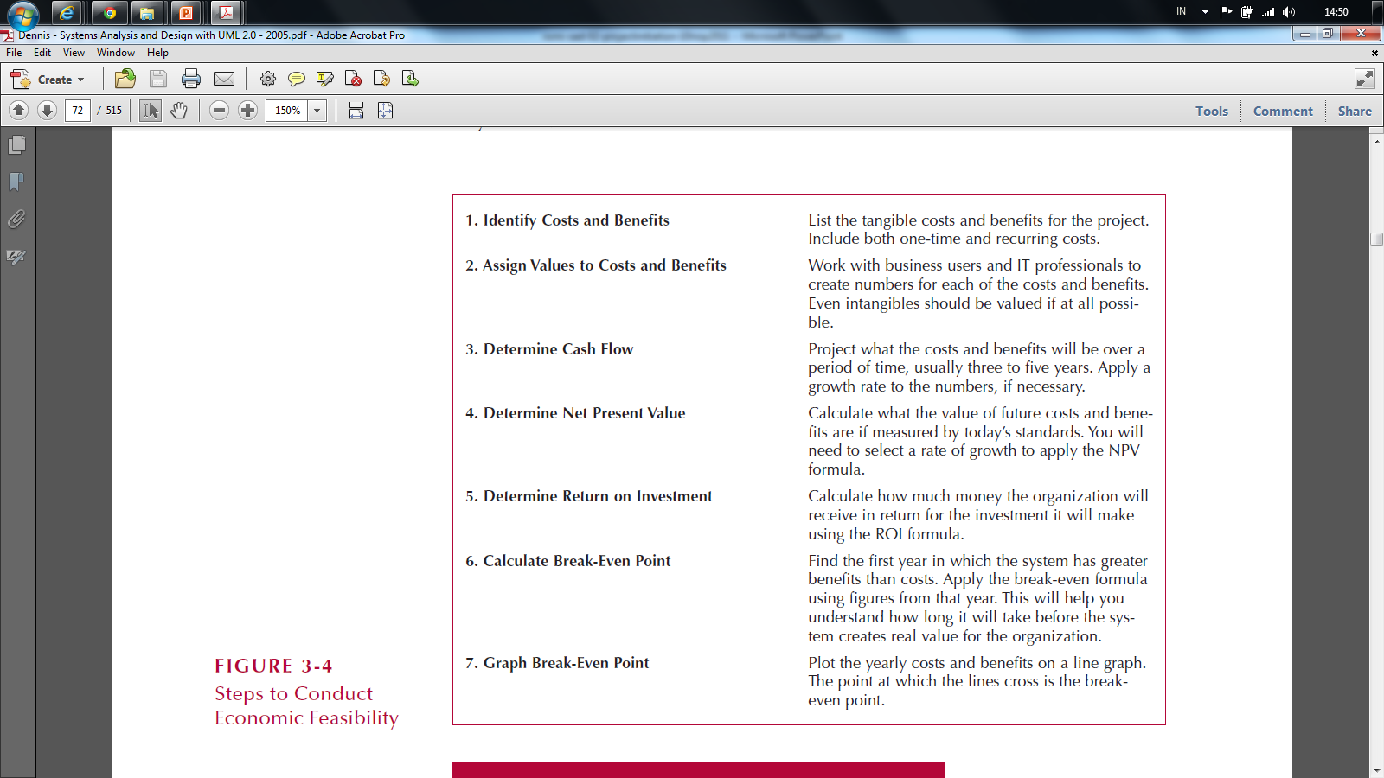
Economic Feasibility: Should We Build It?
Ex : development, operational,etc
Menetapkan biaya user,it profesional hingga biaya tak berwujud
Menentukan arus kas, biaya dan tingkat pertumbuhan 3 s.d 5 thn,/dlm angka
berapa pertumbuhan/ pendapatan yang akan datang jika patokannya saat ini
berapa uang yang akan diterima dari investasi
Menghitung BEP mulai dari awal tahun BEPnya
Grafik - Titik BEP ketika garis melintang

Slide 36
Cost - Benefit Analysis - Cash Flow
Project costs and benefits over several years (3–5)
Biaya dan manfaat proyek selama beberapa tahun (3-5)
Use normal growth rates for sales etc.
Gunakan tingkat pertumbuhan normal untuk penjualan
Total added to determine
Total ditambahkan untuk menentukan
Overall Benefits = Total Benefits – Total Costs
Manfaat Keseluruhan = Total Manfaat - Total Biaya
Higher number is better
Angka yang lebih tinggi lebih baik

Slide 37
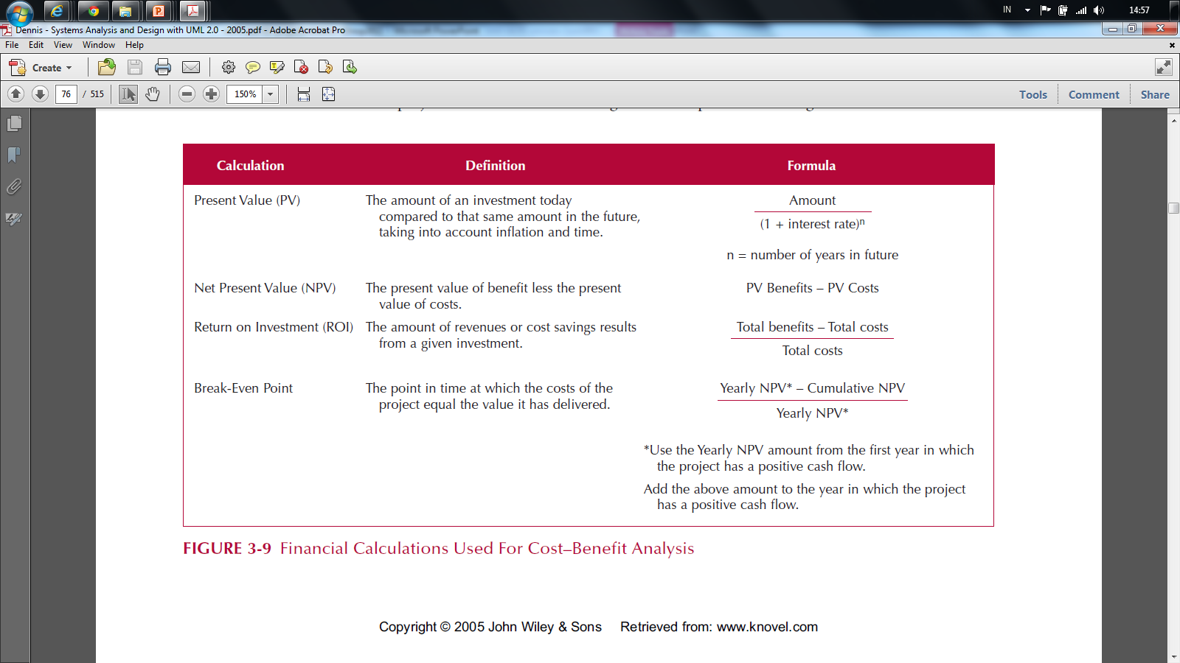
Cost-Benefit Analysis - Cash Flow

Slide 38
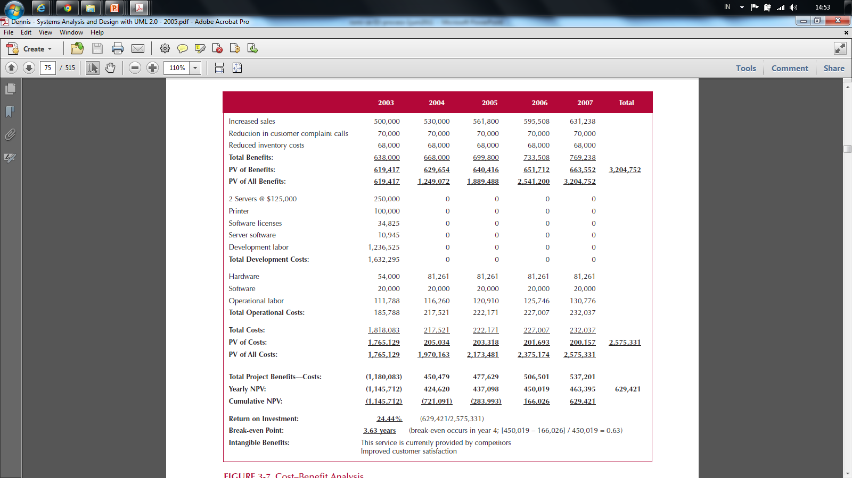
Cash Flow Plan

Slide 39
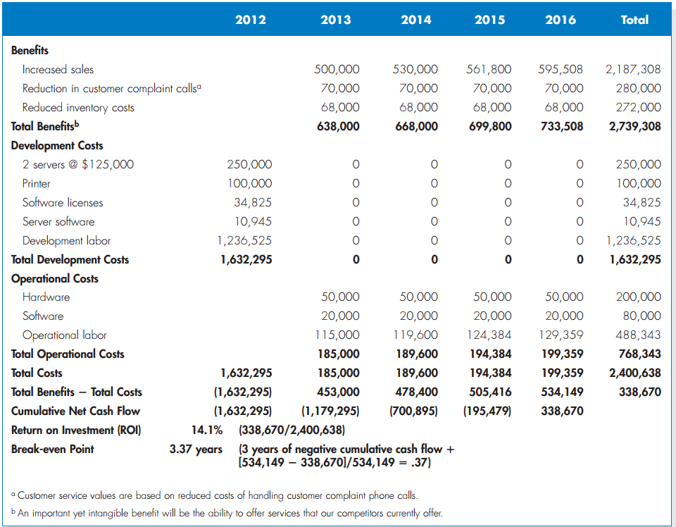

Slide 40
Present Value (PV) - Nilai sekarang
The amount of an investment today compared to the same amount n years in the future
Taking into account inflation and time
(nilai uang saat ini untuk nilai tertentu di masa yang akan datang)
PV =
Ket:
PV : nilai tahun ke 0
Amount : nilai pada akhir tahun ke n
Interest Rate : Suku bunga
n : jumlah waktu (tahun)
Amount
(1 + Interest Rate)^{n}

Slide 41
Net Present Value

Slide 42
Net Present Value (NPV) selisih Pengeluaran dan pemasukan
The present value of benefit less the present value of cost
NPV = PV Benefits – PV Costs
Manfaat NPV :
mengukur kemampuan dan peluang investasinya hingga beberapa tahun yang akan datang,
investasi tersebut akan menguntungkan bagi mereka?
Atau merugikan?
Jika memang menguntungkan, seberapa besar margin keuntungannya?
Apakah cukup worth itu untuk dijalankan?
Ataukah tidak sebanding dengan effort yang dikeluarkan?

Slide 43
NPV Calculation

Slide 44
Return on Investment (ROI) Laba Atas Investasi
The Amount of revenue or cost savings results from a given investment
ROI =
Total Benefits – Total Costs
Total Costs

Slide 45
Return on Investment (ROI) (contd-2) Manfaat ROI
Mengukur efisiensi penggunaan modal yang bekerja, efisiensi produksi, dan efisiensi penjualan.
Membandingkan efisiensi penggunaan modal perusahaan lain yang sejenis
Mengetahui perusahaannya berada di bawah, sama, atau di atas rata-rata.
Mengetahui letak kelemahan dan kekuatan perusahaan dengan perusahaan lain sejenis
Mengukur efisiensi tindakan-tindakan tiap devisi
Mengukur profitabilitas dari produk yang dihasilkan
Keperluan kontrol, maupun perencanaan

Slide 46
ROI Calculation

Slide 47
Break Even Point (BEP)
The point in time when the costs of the project equal (sama) the value it has delivered
BEP =
* Use the yearly NPV amount from the first year in which project has positive cash flow
Yearly NPV* – Cumulative NPV
Yearly* NPV

Slide 48
Break Even Point (BEP) – (contd-2)
Break Even Point digunakan untuk menganalisis proyeksi sejauh mana banyaknya jumlah unit yang diproduksi berapa uang yang harus diterima untuk balik modal.
Komponen BEP :
Fixed Cost (tenaga kerja/karyawan, penyusutan alat,dll)
Variabel Cost (biaya per unit sifatnya dinamis, biaya bahan baku, biaya listrik, dll)
Selling Price (harga jual per unit barang/jasa yang telah diproduksi)

Slide 49
Break Even Point (BEP) – (contd-3)
Rumus Break Even Point
Dasar Unit
Berapa unit jumlah barang/jasa yang harus dihasilkan untuk mendapat titik impas: BEP = FC /(P-VC)
Dasar Penjualan
Berapa rupiah nilai penjualan yang harus diterima untuk mendapat titik impas:
FC/ (1 – (VC/P))* Penghitungan (1 – (VC/P))
BEP Laba /target laba
BEP – Laba = (FC + Target Laba) / (P – VC)
BEP – Pembuktian Laba
Laba : Penjualan – (FC + Total VC))

Slide 50
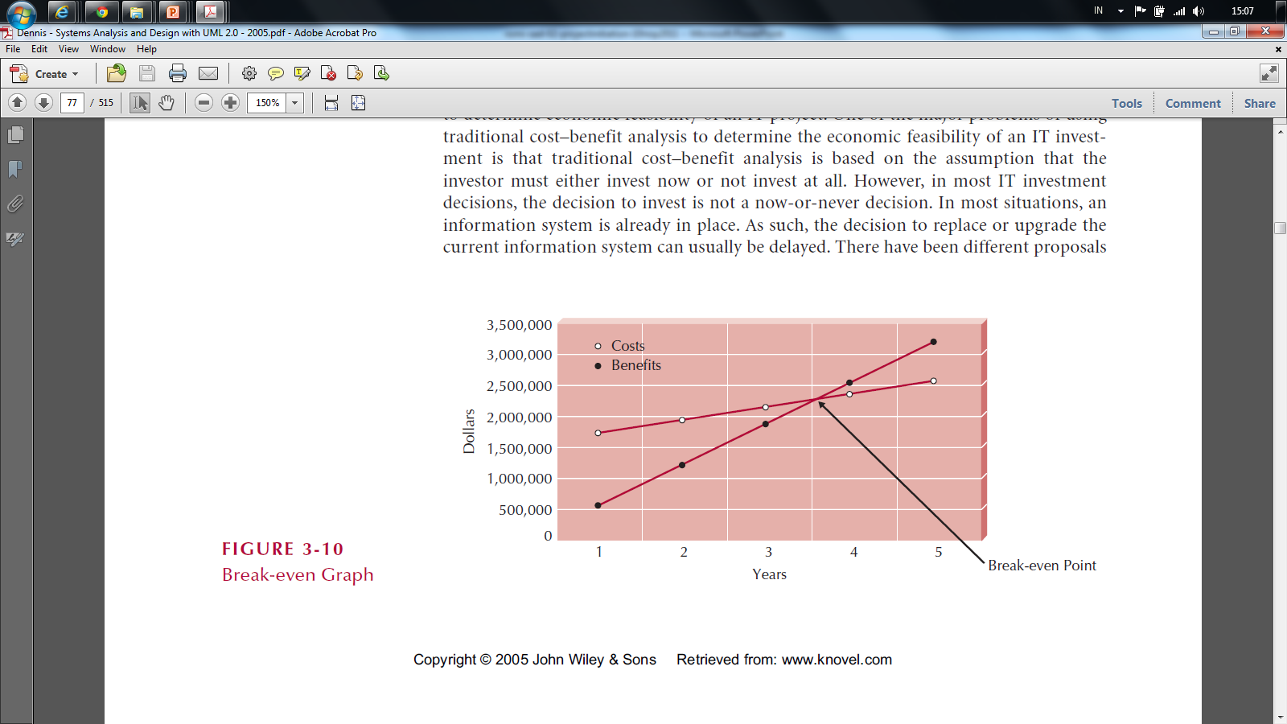
Break Even Point (BEP)

Slide 51
Cash Flow Plan

Slide 52
Feasibility Analysis - Organizational Feasibility Proses Pengukuran Kelayakan
Strategic Alignment
How well (baik/bagus/cocok/praktis) does the project match up with the business strategy?
Stakeholder analysis considers
Project champion(s)
Organizational management
System users
Anybody affected by the change

Slide 53
Stakeholder Analysis Considers
Project champion(s)
High-level non-IS executive
Shepherds project to completion
It's good to have more than one
Organizational management
Need this support to sell system to organization
System users
In the loop so end system meets needs (Memenuhi kebutuhan)

Slide 54
Feasibility Analysis – Case Study
Technical feasibility
Economic feasibility
Organizational feasibility

Slide 55
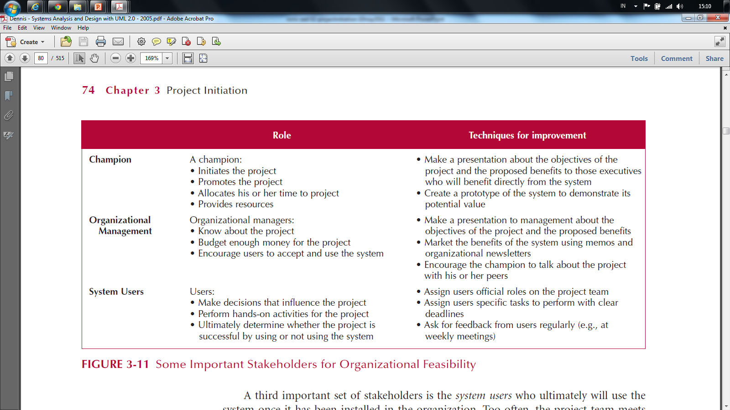
Stakeholder Analysis Considers

Slide 56
Feasibility Analysis Template
Technical Feasibility: Can We Build It?
Familiarity with Application: Less familiarity generates more risk Familiarity with Technology: Less familiarity generates more risk Project Size: Large projects have more risk Compatibility: The harder it is to integrate the system with the company’s existing technology, the higher the risk
Economic Feasibility: Should We Build It?
Return on Investment (ROI) over 3 years Break-even Point (BEP) Total benefit after 3 years
Organizational Feasibility: If We Build It, Will They Come?
Project champion(s) Senior management Users Other stakeholders Is the project strategically aligned with the business? proyek selaras secara strategis dengan bisnis?

Slide 57
CD Selection Internet Order Feasibility Analysis Executive Summary
Margaret Mooney and Alec Adams created the following feasibility analysis for the CD Selections Internet Order System Project. The System Proposal is attached, along with the detailed feasibility study
Technical Feasibility The Internet Order System is feasible technically, although there is some risk. CD Selections’ risk regarding familiarity with the application is high The Marketing Department has little experience with Internet-based marketing and sales The IT Department has strong knowledge of the company’s existing order systems; however, it has not worked with Web-enabled order systems CD Selections’ risk regarding familiarity with the technology is medium The IT Department has relied on external consultants and an Information Service Provider to develop its existing Web environment The IT Department has learned about Web technology by maintaining the corporate site Development tools and products for commercial Web application development are available in the marketplace, although the IT department has little experience with them The project size is considered medium risk The project team likely will include less than ten people Business user involvement will be required The project timeframe cannot exceed a year because of the Christmas holiday season implementation deadline, and it should be much shorter The compatibility with CD Selections’ existing technical infrastructure should be good The current Order System is a client-server system built using open standards. An interface with the Web should be possible Retail stores already place and maintain orders electronically An Internet infrastructure already is in place at retail stores and at the corporate headquarters

Slide 58
Economic Feasibility
A cost–benefit analysis was performed; see attached spreadsheet for details. A conservative approach shows that the Internet Order System has a good chance of adding to the bottom line of the company significantly. Return on Investment (ROI) over 3 years: 229 percent Break-even point (BEP): after 1.7 years Total benefit after three years: $3.5 million (adjusted for present value) Intangible Costs and Benefits Improved customer satisfaction Greater brand recognition
Organizational Feasibility
From an organizational perspective, this project has low risk. The objective of the system, which is to increase sales, is aligned well with the senior management’s goal of increasing sales for the company. The move to the Internet also aligns with Marketing’s goal to become more savvy in Internet marketing and sales. The project has a project champion, Margaret Mooney, Vice President of Marketing. Margaret is well positioned to sponsor this project and to educate the rest of the senior management team when necessary. To date, much of senior management is aware of and supports the initiative. The users of the system, Internet consumers, are expected to appreciate the benefits of CD Selections’ Web presence. And, management in the retail stores should be willing to accept the system, given the possibility of increased sales at the store level.

Slide 59
 | 2003 | 2004 | 2005 | Total
Increased sales from new customers | 0 | 750,000 | 772,500
Increased sales from existing customers | 0 | 1,875,000 | 1,931,250
Reduction in customer complaint calls | 0 | 50,000 | 50,000
Total Benefits: | 0 | 2,675,000 | 2,753,750
PV of Benefits: | 0 | 2,521,444 | 2,520,071 | 5,041,515
PV of All Benefits: | 0 | 2,521,444 | 5,041,515
Labor: Analysis, Design and Implementation | 162,000 | 0 | 0
Consultant Fees | 50,000 | 0 | 0
Office Space and Equipment | 7,000 | 0 | 0
Software and Hardware | 35,000 | 0 | 0
Total Development Costs: | 254,000 | 0 | 0
Labor: Webmaster | 85,000 | 87,550 | 90,177
Labor: Network Technician | 60,000 | 61,800 | 63,654
Labor: Computer Operations | 50,000 | 51,500 | 53,045
Labor: Business Manager | 60,000 | 61,800 | 63,654
Labor: Assistant Manager | 45,000 | 46,350 | 47,741
Labor: 3 Staff | 90,000 | 92,700 | 95,481
Software upgrades and licenses | 4,000 | 1,000 | 1,000
Hardware upgrades | 5,000 | 3,000 | 3,000
User training | 2,000 | 1,000 | 1,000
Communications charges | 20,000 | 20,000 | 20,000
Marketing expenses | 25,000 | 25,000 | 25,000
Total Operational Costs: | 446,000 | 452,700 | 464,751
Total Costs: | 700,000 | 452,700 | 464,751
PV of Costs: | 679,612 | 426,713 | 425,313 | 1,531,638
PV of all Costs: | 679,612 | 1,106,325 | 1,531,638
Total Project Costs Less Benefits: | (700,000) | 2,222,300 | 2,288,999
Yearly NPV: | (679,612) | 2,094,731 | 2,094,758 | 3,509,878
Cumulative NPV: | (679,612) | 1,415,119 | 3,509,878
Return on Investment (ROI): | 229.16% | (3,509,878/1,531,638)
Break-even Point (BEP): | 1.32 years | (BEP in Year 2 = [2,094,731 – 1,415,119] / 2,094,731 = 0.32)

Slide 60
Feasibility Analysis - Online ATM System
Margaret Mooney and Alec Adams created the following feasibility analysis for the Online ATM System Project.
1. Technical Feasibility The Online ATM System is feasible technically, although there is some risk. 1.1 Online ATM System’s risk regarding familiarity with the application is high The Marketing Department has little experience with Internet-based marketing and sales The IT Department has strong knowledge of the company’s existing ATM systems, however, it has not worked with Web-enabled ATM systems. 1.2 Online ATM System’s risk regarding familiarity with the technology is medium The IT Department has relied on external consultants to develop its existing Web env. The IT Department has learned about Web technology by maintaining the corporate site 1.3 The project size is considered medium risk The project team likely will include less than ten people Business user involvement will be required The project timeframe cannot exceed a year and it should be much shorter 1.4 The compatibility with existing technical infrastructure should be good The current ATM System is a client-server system built using open standards. An interface with the Web should be possible Retail bank already place and maintain orders electronically An Internet infrastructure already is in place at retail bank and at the corporate headquarters

Slide 61
2. Economic Feasibility
A cost–benefit analysis was performed. A conservative approach shows that the Online ATM System has a good chance of adding to the bottom line of the company significantly. Return on Investment (ROI) over 3 years: 229 percent Break-even point (BEP) occurs: after 1.7 years Total benefit after three years: $3.5 million Intangible Costs and Benefits Improved customer satisfaction Greater brand recognition
3. Organizational Feasibility
From an organizational perspective, this project has low risk. The objective of the system, which is to increase sales, is aligned well with the senior management’s goal of increasing sales for the company. The move to the Internet also aligns with Marketing’s goal to become more savvy in Internet marketing and sales. The project has a project champion, Margaret Mooney, Vice President of Marketing. Margaret is well positioned to sponsor this project and to educate the rest of the senior management team when necessary. Much of senior management is aware of and supports the initiative.

Slide 62
Exercise: Membuat Feasibility Analysis
Lihat contoh Feasibility Analysis untuk Internet Order Project
Perhatikan kembali System Request yang sebelumnya sudah kita buat
Buat Feasibility Analysis dari system yang akan kita buat tersebut

Slide 63
2.3 Project Size Estimation

Slide 64
Project Size Estimation
Software Estimation, Demystifying the Black Art - Steve McConnell
metode Estimasi
count
compute
Judge
Kalo ditanya berapa tinggi pohon, paling baik adalah ambil meteran dan ukur pohonnya (Count).
Jika tidak bisa kita compute. Contohnya, di sebelah pohon ada pagar dan di atas pagar ada tiang lampu. Kita compute jumlah tinggi pagar dan tinggi tiang lampu, sehingga dapat tinggi pohon.
Hanya kalau tidak ada cara lain, baru kita judge. Dikira2 tingginya berapa.
Dalam kaitannya dalam estimasi, idealnya yang kita estimasi hanyalah project size. Metric lainnya akan kita compute dari project size ini. (SLOC - Source Lines of Code ) sangat akurat dalam menentukan ukuran project.
Project size merupakan ukuran suatu project. Dengan project size, kita bisa membandingkan dua aplikasi yang berbeda.

Slide 65
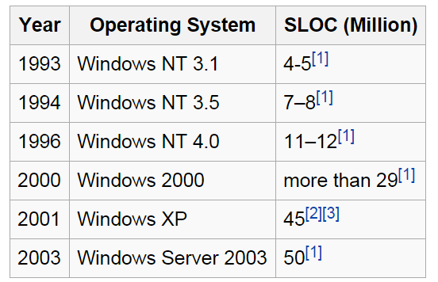

“Size” of Software Systems
Source: Wikipedia
source lines of code (SLOC)

Slide 66
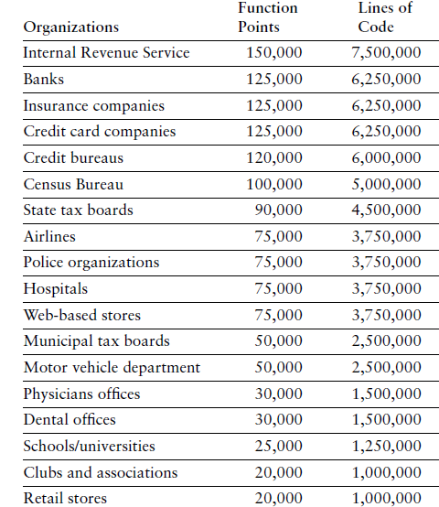
“Size” of Software Systems
Caper Jones, The Economic of Software Quality (2012)

Slide 67
Software Effort Estimation Methods
Estimasi Usaha (Effort)
1. Simply Method
(Industry Std Percentages)
Use the time spent for planning
Estimate System Size (Function Point)
3. Use Case Point
(Gustav Karner, 1993)
Estimate System Size (Use Case Points)
Along with industry standard percentages
Estimate the overall time for the project
2. Function Point
(Allen Albrecht, 1979)
Estimate Effort Required (Person-Month)
Estimate Time Required (Month)
Estimate Effort Required (Person-Month)
Estimate Time Required (Month)

Slide 68
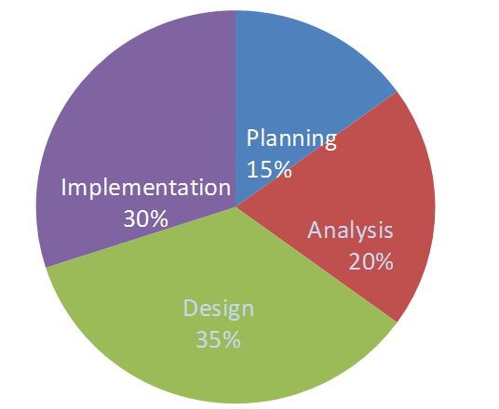
1. Simply Method

Slide 69
Time Spent for Each Phase Waktu tiap kegiatan
We are given that so

Slide 70
Estimate the Overall Time
Planning Analysis Design Implementation
Industry
Standard
For Web 15% 20% 35% 30%
Applications
Effort
Required 4 5.33 9.33 8
in Time (month)
Example: Analysis month

Slide 71
2. Function Point
Untuk mengatasi kesulitan yang berhubungan dengan kode program sebagai ukuran dari ukuran perangkat lunak, dan untuk membantu dalam memprediksi effort dalam development perangkat lunak.

Slide 72
Function Point
Untuk mengukur fungsionalitas yang dimiliki oleh sebuah sistem perangkat lunak.
Memperkirakan biaya atau usaha yang diperlukan dalam tahap perancangan, coding, maupun pengujian.
Memperkirakan jumlah error yang ditemui pada saat pengujian
Memperkirakan jumlah komponen atau sumber baris pada tahap implementasi
Intinya : menghitung berapa screen input, screen output, jumlah tabel database, dan interaksinya dengan aplikasi lain.

Slide 73
Effort
Kerja real yang kita lakukan dalam menyelesaikan project.
Satuannya adalah mandays atau manhour. Misalnya suatu aplikasi diestimasi membutuhkan effort 10 mandays.
Artinya aplikasi ini akan selesai bila dikerjakan 1 orang selama 10 hari terus menerus. Atau 5 hari bila ada 2 pekerja.
Effort tidak mempertimbangkan libur ataupun cuti.

Slide 74
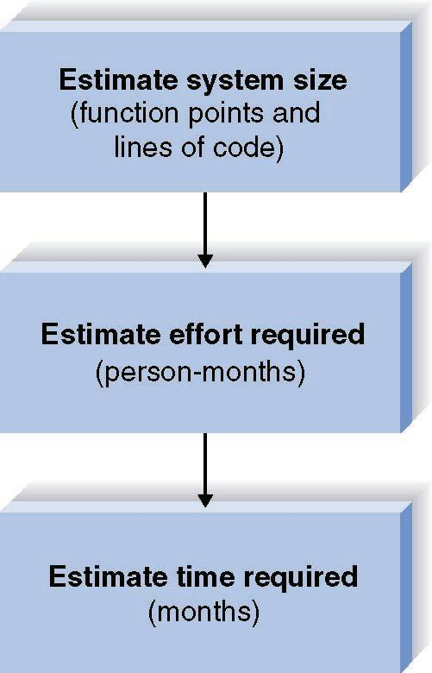
Function Point Approach
(Allen Albrecht, 1979)

Slide 75
A. Function Points Estimation -- Step One (TUFP)
Tipe Input (EI), Berkaitan dengan interface yang lakukan pengguna/user dalam memasukan data pada aplikasi.
Tipe Output (EO), Berkaitan dengan output yang dihasilkan aplikasi untuk pengguna/user yang dapat berupa laporan di print atau yang ditampilkan pada layar.
Tipe Query/Search/View (EQ), Berkaitan dengan query terhadap data yang tersimpan.
Tipe File/Tabel/Database (ILF), berkaitan dengan logic penyimpan data yang dapat berupa file atau semacam database relational.
Tipe Interface Eksternal (EIF), Berkaitan dengan komunikasi data pada parangkat/mesin yang lain, contoh nya adalah membuat aplikasi SMS Server yang membutuhkan koneksi pada perangkat keras Modem telepon.
Complexity
Low : Api, transaksi 3 kebawah
Medium : Melalui Protokol TCP/IP, transaksi 4 sampai 7
High : GUI atau Web Page, transaksi lebih dari 7 transaksi

Slide 76
A. Function Points Estimation -- Step One (TUFP)
Complexity
Description Low Medium High Total
Inputs __x 3 __x 4 __x 6 ____
Outputs __x 4 __x 5 __x 7 ____
Queries __x 3 __x 4 __x 6 ____
Files __x 7 __x 10 __x 15 ____
Program __x 5 __x 7 __x 10 ____
Interfaces
TOTAL UNADJUSTED FUNCTION POINTS ____

Slide 77
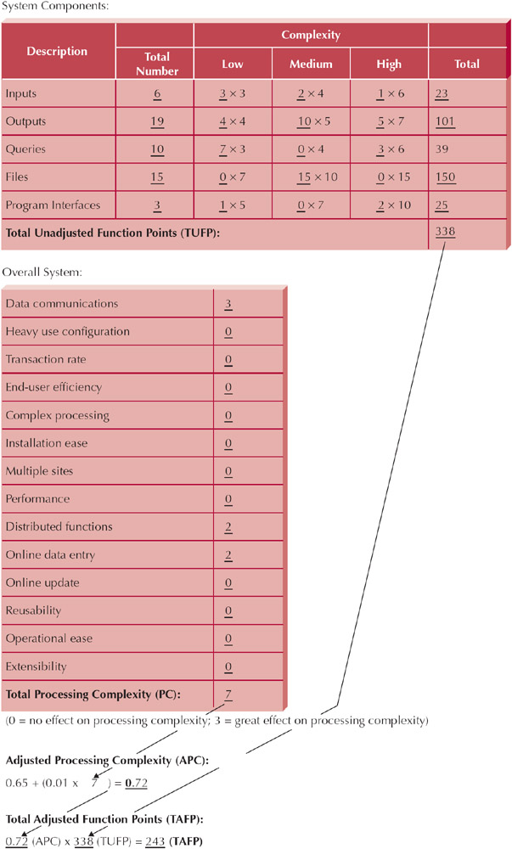
Example: CD Selection System

Slide 78
Function Points Estimation -- Step Two (Processing Complexity)
NO | Karakteristik Sistem | Keterangan
1 | Data Communications | Berapa banyak fasilitas komunikasi yang digunakan untuk membantu pengiriman atau pertukaran Informasi dengan aplikasi?
2 | Heavy Use Configuration | Seberapa berat platform hardware digunakan yang merupakan lokasi eksekusi dari aplikasi?
3 | Transaction Rate | Seberapa sering transaksi dieksekusi setiap hari, minggu, bulan, dst?
4 | End-User efficiency | Apakah aplikasi dirancang untuk efisiensi end-user?
5 | Complex Processing | Apakah aplikasi memiliki logika yang luas atau pemrosesan matematika?
6 | Installation Ease | Seberapa sulit konversi dan instalasi?
7 | Multiple sites | Apakah aplikasi dirancang, dikembangkan, dan didukung khusus untuk diinstal pada banyak site/perusahaan?
8 | Performance | Berapa waktu tanggapan dari sistem atau keluaran yang dibutuhkan oleh user?
9 | Distributed functions | Bagaimana cara menangani data yang terdistribusi dan fungsi pemrosesannya?
10 | On-line data entry | Berapa persen Informasi yang dimasukan secara online?
11 | On-line update | Berapa banyak ILF di update melalui transaksi online?
12 | Reusability | Apakah aplikasi dikembangkan untuk memenuhi satu atau banyak kebutuhan?
13 | Operational Ease | Seberapa efektif atau terotomatisasinya aplikasi pada saat start-up, back-up, dan prosedur recovery?
14 | Extensibility / Facilitate change | Apakah aplikasi dirancang, dikembangkan, dan didukung khusus untuk memfasilitasi perubahan?

Slide 79
Function Points Estimation -- Step Two (Processing Complexity)
Scale of 0 to 3
Data Communications _____
Heavy Use Configuration _____
Transaction Rate _____
End-User efficiency _____
Complex Processing _____
Installation Ease _____
Multiple sites _____
Performance _____
Distributed functions _____
On-line data entry _____
On-line update _____
Reusability _____
Operational Ease _____
Extensibility _____
Processing Complexity (PC) _____

Slide 80
Pertanyaan-Pertanyaan Step Two (Processing Complexity)
Untuk menghitung Fi, pertanyaan-pertanyaan di bawah ini dijawab dengan memberi nilai antara 0 s.d 3
Apakah sistem memerlukan backup dan recovery?
Apakah diperlukan fasilitas komunikasi data?
Apakah diperlukan fasilitas ‘distributed processing’?
Apakah kinerja sangat penting?
Apakah sistem akan dijalankan pada lingkungan yang sudah ada yang sudah terpakai secara penuh?
Apakah memerlukan pemasukan data secara ‘on-line’?
Apakah pemasukan data ‘on-line’ terjadi pada transaksi input thd layar atau operasi ganda?
Apakah file master di’update’ secara on-line?
Apakah input,output, file secara inquiry begitu kompleks?
Apakah proses internal begitu kompleks?
Apakah kode yang dibuat harus dapat digunakan ulang?
Apakah konversi dan instalasi termasuk dalam perancangan?
Apakah sistem dirancang untuk dapat diinstall pada berbagai organisasi yang berbeda?
Apakah aplikasi dirancang untuk memberikan fasilitas perubahan dan kemudahan pemakaian bagi user?

Slide 81
Example: CD Selection System

Slide 82
Function Point Estimation -- Step Three (TAFP)
Processing Complexity (PC) = 7
(From Step Two)
Adjusted Processing
Complexity (PCA) = 0.65 + (0.01 * 7 ) = 0.72
Total Adjusted
Function Points (TAFP): 338 * 0.72 = 243
(From Step One)

Slide 83
Adjusted Processing Complexity
Choose standard Adjusted Project Complexity (PCA) from the range:
0.65 Simple systems
1.0 "Normal" systems
1.35 Complex systems

Slide 84
Converting Function Points to Lines of Code
Language
LOC/Function Code Point
C
COBOL
JAVA
C++
Turbo Pascal
Visual Basic
PowerBuilder
HTML
Packages
(e.g., Access, Excel)
130
110
55
50
50
30
15
15
10-40
Source: Capers Jones, Software Productivity Research

Slide 85
Lines of Codes (LOC)
Line of Codes (LOC) = TAFP * LOC/TAFP
Example:
If TAFP = 243 Then we build the software using Java
LOC = (243 * 55) = 13365 line of codes

Slide 86
Contoh Jenis Aplikasi dan FP
Caper Jones, The Economic of Software Quality (2012)

Slide 87
B. Estimating Effort
Effort = 1.4 * thousands-of- lines-of-code
(in Person- Months)
Example:
If LOC = 13365 Then...
Effort = (1.4 * 13.365) = 18.711 Person Months

Slide 88
C. Estimating Time
Time = 3.0 * person-months^{1/3}
(in Months)
Example:
If LOC = 13365 Then...
Effort = (1.4 * 13.365) = 18.711 person-months
Time = 3.0 * 18.711 ^{1/3} = 7.9 month

Slide 89
Calculate System Size
Imagine that job hunting has been going so well that you need to develop a system to support your efforts. The system should allow you to input information about the companies with which you interview, the interviews and office visits that you have scheduled, and the offers that you receive. It should be able to produce reports, such as a company contact list, an interview schedule, and an office visit schedule, as well as produce thank-you letters to be brought into a word processor to customize. You also need the system to answer queries, such as the number of interviews by city and your average offer amount. The system will be developed using Java.

Slide 90
Hitung Size dari Sistem dengan Function Point
Sebuah perusahaan membutuhkan sistem job seeker untuk pencari kerja dan perusahaan pembuka lowongan pekerjaan
Sistem memungkinkan pencari kerja untuk menginput data curriculum vitae. Di sisi lain, perusahan pembuka lowongan kerja bisa menginput data perusahaan dan lowongan pekerjaan yang disediakan
Pencari kerja dapat melakukan pencarian (query) tentang lowongan pekerjaan apa saja yang tersedia, sedangkan pembuka lowongan kerja mencari tentang siapa saja yang sudah mendaftar di suatu lowongan pekerjaan
Sistem mampu memproduksi laporan dan statistik lengkap tentang pencari kerja, perusahaan, jenis lowongan pekerjaan dan tren lowongan kerja yang sedang populer
Laporan statistik akan disajikan dalam bentuk infografik dan juga tersedia dalam bentuk file pdf yang bisa didownload
Sistem akan dikembangkan dengan menggunakan bahasa pemrograman Java

Slide 91
Complexity
Description Low Medium High Total
Inputs __x 3 __x 4 __x 6 ____
Outputs __x 4 __x 5 __x 7 ____
Queries __x 3 __x 4 __x 6 ____
Files __x 7 __x 10 __x 15 ____
Program __x 5 __x 7 __x 10 ____
Interfaces
TOTAL UNADJUSTED FUNCTION POINTS ____

Slide 92
TUFP
 | Fungsi | Bobot | Total
Input | 3 | 3 | 9
Output | 4 | 4 | 16
Queries | 2 | 3 | 6
File | 2 | 7 | 14
Program Interface | 5 | 5 | 25
TUFP |  |  | 70

Slide 93
Processing Complexity
Data Communications 1
Heavy Use Configuration 0
Transaction Rate 0
End-User efficiency 0
Complex Processing 0
Installation Ease 0
Multiple sites 0
Performance 0
Distributed functions 0
On-line data entry 2
On-line update 2
Reusability 0
Operational Ease 1
Extensibility 0
TOTAL 6

Slide 94
TAFP
Processing Complexity (PC) = 6
Adjusted Processing
Complexity (PCA) = 0.65 + (0.01 * 6 ) = 0.71
Total Adjusted
Function Points (TAFP): 70 * 0.71 = 49.7

Slide 95
LOC → Effort (ManMonth)→ Time (Month)
LOC = 55*49.7 = 2733.5
Effort = 1.4*2.7335 = 3.83 MM
Time = 3.0 * 3.83 ^{(1/3)} = 4.6 M

Slide 96
Exercise: Membuat Project Size Estimation
Lihat contoh Project Size Estimation
Perhatikan kembali System Request, Feasibility Analysis yang sebelumnya sudah kita buat
Buat Project Size Estimation dari system yang akan kita buat tersebut

Slide 97
Perencanaan Proyek
Proyek Perangkat Lunak

Slide 98
Perencanaan Proyek
Merupakan pembuatan dokumen resmi proyek yang Diacu dalam pelaksanaan, pengawasan, dan penutupan proyek, yang menjamin proyek mencapai sasarannya bila diikuti dengan baik.
Disetujui oleh pemberi kerja.
Diberikan kepada pihak-pihak yang dicantumkan dalam rencana manajemen komunikasi
Dilengkapi dengan rincian pendukungnya.

Slide 99
Tujuan Perencanaan Proyek
Sebagai pedoman pelaksanaan, pengawasan dan penutupan proyek
Mendokumentasi asumsi-asumsi yang dijadikan dasar dalam perencanaan
Mendokumentasi keputusan penting dan pertimbangannya
Memfasilitasi komunikasi diantara stakeholder
Mendefinisikan pemeriksaan (review) manajemen dalam hal: isi, cakupan, waktu
Sebagai dasar (baseline) untuk menilai kinerja dalam kegiatan pengawasan proyek

Slide 100
Elemen Rencana Proyek
Lingkup Proyek, alternatif & feasibility
Membagi proyek dalam rincian kegiatan
Jadwal kegiatan
Rencana komunikasi
Menentukan standar & prosedur proyek
Identifikasi & perkiraan resiko
Membuat budget
Rencana Proyek Dasar

Slide 101
Langkah Perencanaan Proyek
Menentukan sasaran & lingkup proyek
Menentukan lifecycle
Membuat struktur organisasi/tim proyek
Memilih tim proyek
Menentukan resiko-resiko
Membuat Work Breakdown Structure (WBS)
Identifikasi tugas/aktivitas dan ketergantungannya
Estimasi
Menentukan sumber-sumber daya
Membuat jadwal kegiatan

Slide 102
WORK BREAKDOWN STRUCTURE (WBS)

Slide 103
Work Breakdown Structure
Teknik untuk :
Membagi keseluruhan proyek ke dalam komponen-komponen
Memecah komponen ke level-level berikutnya sampai dengan tugas
Sampai dengan setiap tugas merupakan unit yang dapat dikelola (misalnya oleh manajer teknik)
Direncanakan
Dianggarkan
Dijadwalkan
Dikendalikan
Menampilkan gambar/grafik tentang hirarki proyek

Slide 104
Work Breakdown Structure
Tujuan :
Melengkapi komunikasi antar personel proyek
Menjaga konsistensi dalam pengendalian dan pelaporan
Cara efektif untuk melengkapi tugas manajemen
Manfaat :
Mengurangi kompleksitas
Fasilitas penjadwalan dan pengendalian

Slide 105
Pendekatan untuk mengembangkan WBS
Menggunakan pedoman
Pendekatan analogi
Pendekatan top down
Pendekatan dari bawah ke atas
Pendekatan pemetaan pikiran

Slide 106
Sistem Penomoran WBS
Untuk Level 0 atau judul proyek adalah 0.0.
Pada Level 1 masing-masing item diberi nomor N.0.
Contoh : 1.0, 2.0, dst.
Kemudian masing-masing item pada Level 2 dibawah item N.0 pada Level 1 diberi nomor N.1, N.2, dst.
Contoh : di bawah Level 1 item Analysis yang bernomor 2.0, kita mempunyai item 2.1, 2.2, dst.
Sedangkan untuk Level 3, kita tambahkan titik dan digit dari nomor di Level 2.
Contoh : dibawah 2.1 kita harus menuliskan 2.1.1, 2.1.2, dst.

Slide 107
Langkah membuat WBS
Pecah setiap fungsi ke dalam tiga sub fungsi :
Menerima masukan & memasukkannya ke bentuk yang berkaitan
Menstransformasikan masukan ke dalam keluaran yang dibutuhkan
Menyiapkan keluaran kedalam bentuk akhir yang diminta
Lakukan dekomposisi secara iterative
Mendefinisikan elemen pekerjaan dengan kata benda dan kata sifat – bukan kata kerja
Tidak seluruh cabang mempunyai level yang sama
Jika WBS sangat kompleks untuk ditampilkan dalam satu peta, maka pecahkan setiap level subfungsi dalam peta yang terpisah
Kaji & perbaiki WBS oleh semua kelompok yang berkaitan

Slide 108
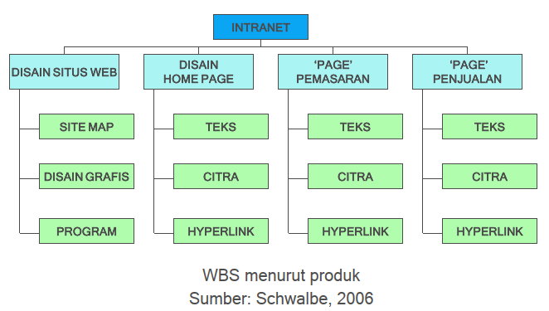
Contoh WBS (bentuk hirarki)
WBS menurut produk Sumber: Schwalbe, 2006

Slide 109
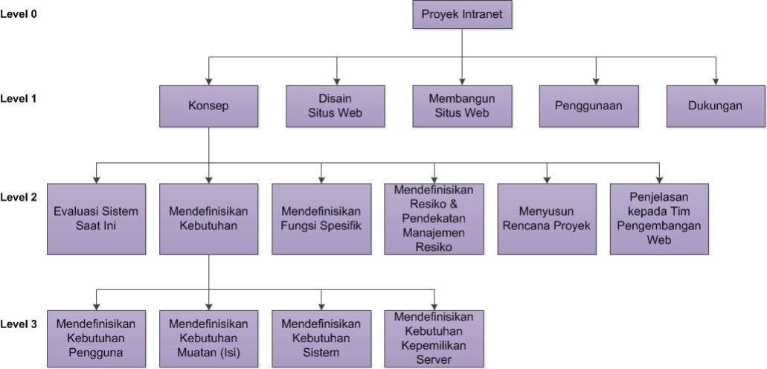
Contoh WBS (bentuk hirarki)
WBS menurut tahapan Sumber: Schwalbe, 2006

Slide 110
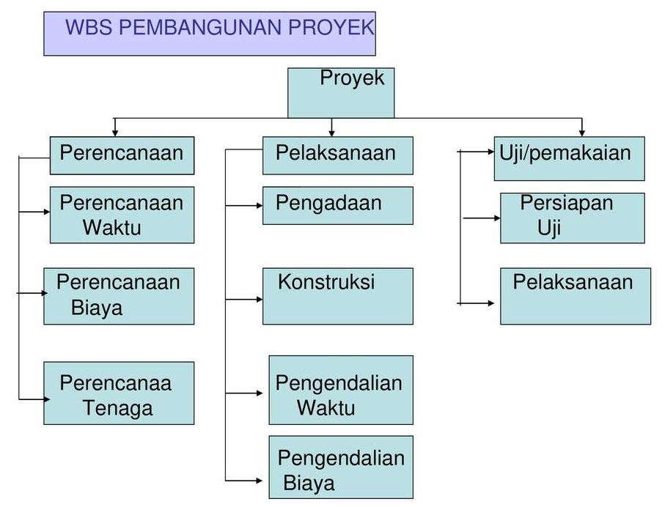
Contoh WBS (bentuk hirarki)

Slide 111
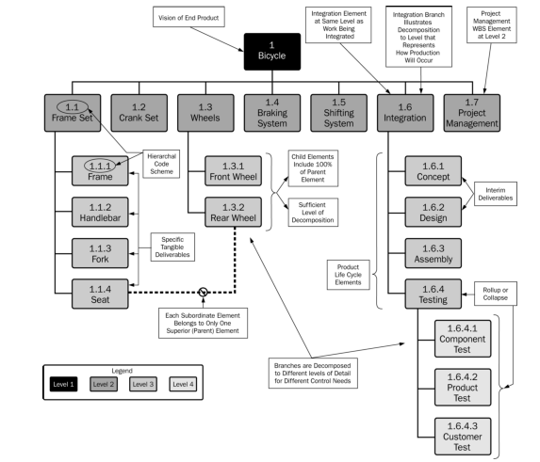
Contoh WBS (bentuk hirarki)

Slide 112
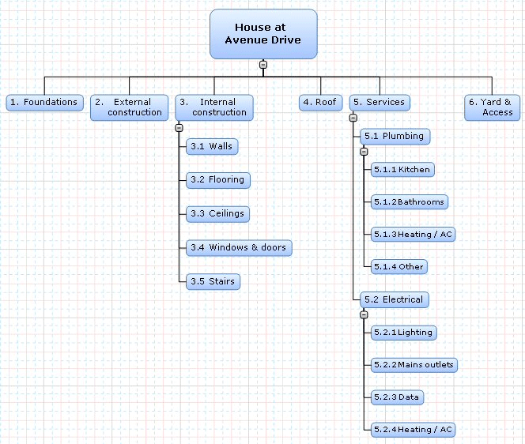
Contoh WBS (bentuk hirarki)

Slide 113
Contoh WBS (bentuk struktur )
1.0 Konsep
1.1 Evaluasi sistem yang ada
1.2 Pendefinisian kebutuhan
1.2.1 Mendefinisikan kebutuhan pengguna
1.2.2 Mendefinisikan kebutuhan muatan (isi)
1.2.3 Mendefinisikan kebutuhan sistem
1.2.4 Mendefinisikan kebutuhan kepemilikan server
1.3 Mendefinisikan fungsi spesifik
1.4 Mendefinisikan resiko dan pendekatan manajemen resiko
1.5 Menyusun rencana proyek
1.6 Penjelasan kepada tim pengembangan web
2.0 Desain situs web
3.0 Membangun (konstruksi) situs web
4.0 Penggunaan
5.0 Dukungan

Slide 114
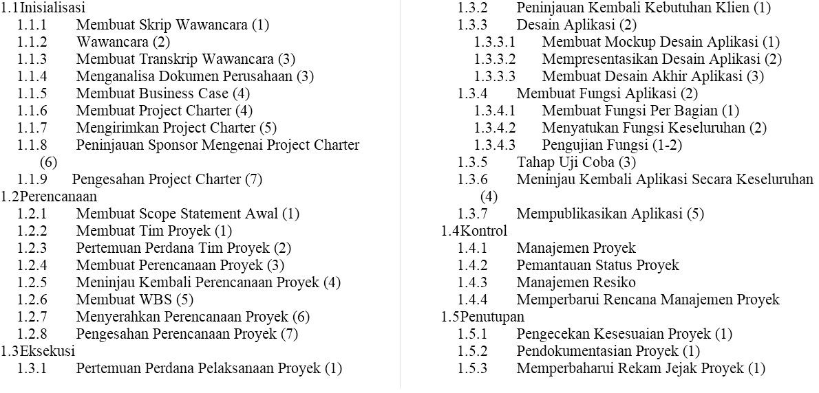
Contoh WBS (bentuk struktur ) Aplikasi Mobile Yayasan

Slide 115
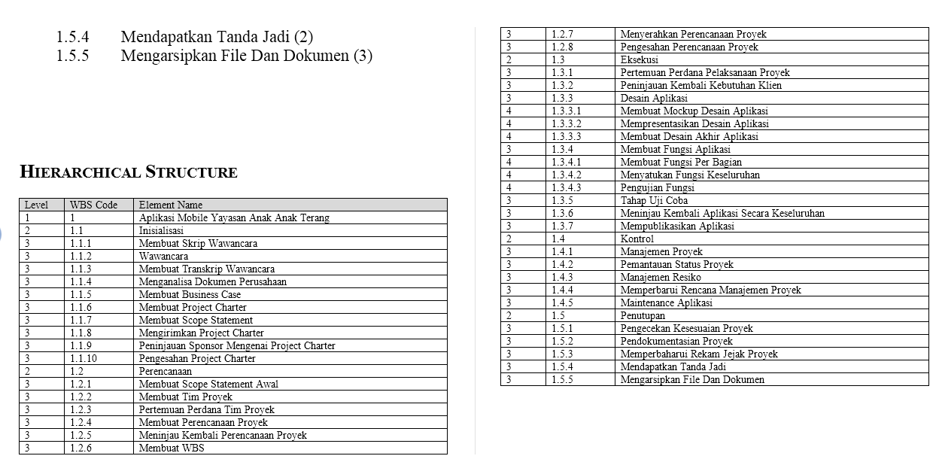

Slide 116
TUGAS
Buatlah WBS (dalam bentuk hirarki atau bentuk struktur) berdasarkan tahapan pembangunan perangkat lunak atau sesuai system Request masing-masing.

Slide 117
08. Manajemen Waktu Proyek

Slide 118
Pendahuluan
Manajemenwaktuproyekdibutuhkanuntukmengaturagar Penyelasaianproyeksesuaiwaktuyangditetapkan
Kegiatandalammanajemenwaktuproyekmeliputi:
Penyusunanjadwalproyek
Monitoringjadwalproyek
Pengontrolanperubahanjadwalproyek
Metodediagrambalok(barchart)dananalisisjaringankerja (networkanalysis)dapatdigunakanuntukmenyajikan perencanaandanpengendalian,khususnyajadwalkegiatan proyeksecarasistematisdananalitis.

Slide 119
Network
Project Network is the tool used for planning, scheduling, and monitoring the project/activity progress.
The network is developed from the information collected for WBS and is a graphic flow chart of the project job plan.

Slide 120
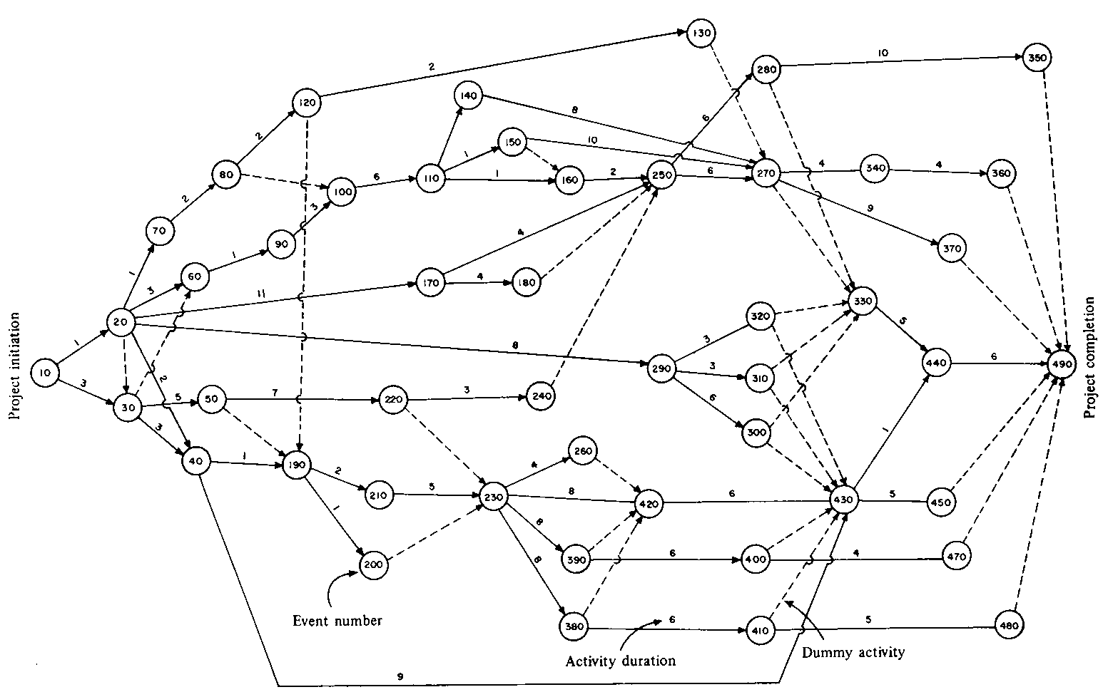
Network

Slide 121
Project Network
Sebuah pernyataan secara grafis dari kegiatankegiatan yang diperlukan dalam mencapai suatu tujuan akhir.
Manfaat :
Menyusun urutan kegiatan proyek yang memiliki sejumlah besar komponen dengan hubungan ketergantungan yang kompleks.
Membuat perkiraan jadwal proyek.
Mengusahakan fluktuasi minimal penggunaan sumberdaya

Slide 122
Network Diagram – Serial Sequential Logic
1
2
3
4
Desain
Sistem
Analisis
Pemrograman
Pengujian
5
6
7
8
Instalasi
Dokumentasi
Training
Pemeliharaan

Slide 123



Network Diagram – Non Serial Sequential Logic
1
2
Desain
Sistem
Analisis
4
3
Pengujian
Pemrograman
5
6
7
8
Instalasi
Dokumentasi
Training
Pemeliharaan

Slide 124
Metode Network Diagram
Metode jalur kritis (CPM)
Teknik evaluasi dan review proyek (PERT)
Metode diagram pendahuluan (PDM)

Slide 125


Perbandingan : CPM, PERT, PDM
CPM PERT PDM
Memakaiteknikpenyajiansecaragrafisdenganmemakaidiagramanakpanah,lingkaranserta
kaidah-kaidahdasarlogikaketergantungandalammenyusunurutankegiatanpadasuatuproyek.
ActivityonArrow(AOA):
kegiatanpadaanakpanah/kegiatandilambangkandengananak
panah.
ActivityonNode(AON):
kegiatanpadanode
Menggunakan1(satu)
angkaestimasibagi
setiapkegiatan.CPM
banyakdigunakanoleh
kalangan industridan
proyek-proyek
Menggunakan3angkaestimasi,bagitiap
kegiatanyaituoptimistic,pesimistikdan
yang palingmungkin.Dengan
memberikanrentangwaktu iniPERT
dapatmenampungadanyaunsur-unsur
yangbelum pasti, kemudian
menganalisakemungkinankemungkinan
sejauhmanaproyekmenyimpangatau
memenuhisasaranjadwalpenyelesaian.
SehinggaPERTlebihbanyakdigunakan
pada proyek proyek penelitian
&pengembanganyangseringkali
memilikiunsurwaktuyangbelumpasti
Menggunakansatuangka
estimasibagitiapkegiatan.
PDMmenghasilkanjaringan
kerjayanglebihsederhana
dariCPMdanPERT,
terutamauntukproyekyang
kegiatannyaperludipecah
menjadisub-kegiatan.
engineeringkonstruksi

Slide 126
Mekanisme
Identifikasilingkupproyekdanmenguraikannyamenjadi komponen-komponenkegiatan.
Menyusunkomponen-komponenkegiatansesuaiurutan logikaketergantunganmenjadijaringankerja.Urutanini dapatberbentukseridanparalel.
Memberikanperkiraankurunwaktumasing-masing kegiatan.
Identifikasijalurkritis,slack/floatdankurunwaktu penyelesaianproyek.
MeningkatkandayagunadanhasilgunapemakaianSumberdaya
Menentukanjadwalyangpalingekonomis
Meminimalkanfluktuasipemakaiansumberdaya.

Slide 127





Activity On Arrow (AOA)
Kegiatan digambarkan sebagai anak panah yang menghubungkan dua lingkaran yang mewakili dua peristiwa.
Peristiwa/event
Terdahulu
Peristiwa/event
Berikutnya
i j
Kegiatan

Slide 128






Simbol pada AOA
•Melambangkanactivity/kegiatan
•Kegiataninimemerlukanjangkawaktutertentu(duration),dengan
pengggunaansejumlahsumbertenaga,peralatan,bahandan
biaya(resources)
•Panjangdankemiringananakpanahtidakmempunyaiartitertentu
(tidakberskala)
Anakpanah
(arrow)
•Arahanakpanahmenunjukkanarahkegiatandenganarahdarikiri
kekanan.
•Contohkegiatan:
MelakukanAnalisaBusinessProsesSIMKepegawaian,
MelakukanCodingAplikasiSIMKepegawaian,MelakukanTesting
AplikasiSIMKepegawaian
•Melambangkankejadian
•Merupakanujungpertemuandarisatuataulebihkegiatan
•Contohkejadian: SKPL SIM Kepegawaian,DFD SIM
Lingkaran
(node)
Kepegawaiandll
•Melambangkankegiatansemu/dummy
•Kegiatansemudigunakanuntukmembatasimulainyakegiatan-
Anakpanah
terputus
putus
kegiatanataupenghubungkejadianatauperistiwa.
•Perbedaandummydenganactivityialahbahwadummytidak
mempunyaidurationdantidakmemerlukanresources(manpower,
equipmentormaterial)

Slide 129




Beberapa Bentuk Hubungan pada AOA
1.Kegiatan-kegiatanapayang mendahuluinya?
Activity
2.Kegiatan-kegiatanapayang langsungmengikutinya?
Activity
3.Kegiatan-kegiatan apa yang dapat berjalan bersamaan
Activity
Activity
Activity

Slide 130
Hubungan Kebergantungan Antar Kegiatan
1.KegiatanB dimulaisetelahA selesai
A B
2.KegiatanB danC dapatdimulaijika A selesai
B
A
C

Slide 131
Hubungan Kebergantungan Antar Kegiatan
3.KegiatanC dan D dapatdimulaisetelahkegiatanA dan B selesai
A
C
B
D
4.KegiatanC dimulaisetelahA danB selesai, kegiatanD dimulai
setelahB selesai( kegiatandengansatudummy)
A C
B D

Slide 132
Ketentuan Umum AOA
Harus jelas dan mudah dibaca
Harus dimulai dari suatu kejadian (event) dan diakhiri pada suatu kejadian
Anak panah digambarkan dengan garis lurus (boleh garis patah akan tetapi tidak boleh garis lengkung)
Kecuali dalam hal khusus, panjang anak panah tidak ada kaitannya dengan lamanya kurun waktu.
Harus dihindari perpotongan antar anak panah
Tidak boleh ada dummy yang tidak perlu
Nama kegiatan ditulis diatas anak panah
Durasi kegiatan ditulis dibawah anak panah
Satuan waktu yang digunakan satu jenis; jam, hari, minggu, bulan dll.

Slide 133






Activity On Node (AON)
Activity On Node ialah terminologi Manajemen Proyek yang umumnya diterapkan pada metode PDM.
Kegiatan ditulis dalam kotak (Activity on Node-AON) Anak panah hanya menjelaskan hubungan ketergantungan antara kegiatan-kegiatan.
KegiatanA KegiatanB

Slide 134
















Ketentuan Umum AON
Y danZ didahului
olehX
A B C
Y
A tidakdidahuluiolehapapun.
B (C) didahuluiolehA (B).
X
Y danZ dapat
dimulai
bersamaanjika
dikehendaki.
Z
(1)
(2)

Slide 135

















Ketentuan Umum AON
J,K, danL dapat
dimulai
bersamaan(pada
dasarnya
merupakan
aktivitasparalel)
Z didahuluiolehX
danY.
X Z
J
K
M
Y _{A}^{A}
AA didahuluiolehX
danY.
L
tetapi
J,K, danL harus
selesaisebelum
M dimulai.
(3)
(4)

Slide 136
PDM
Kegiatan digambarkan dengan kotak,
Panah antar kotak mewakili ketergantungan
▪Finish-to-start
A selesai, baruB dimulai
A B
▪Finish-to-finish
A selesai, baruB bisaselesai
A B
▪Start-to-start
A mulai, baruB bolehdimulai
A B
▪Start-to-finish
A mulai, baruB bolehselesai
A B

Slide 137
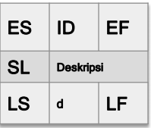
Keterang
d = durasi kegiatan
ID = nomor urut kegiatan
ES = earliest start time = waktu terawal kegiatan dapat dimulai
EF = earliest finish = waktu terawal kegiatan dapat diselesaikan
SL = slack = waktu delay suatu kegiatan
LS = latest start = batas waktu paling lambat kegiatan dimulai tanpa berakibat terlambatnya proyek selesai
LF = latest finish = batas waktu paling lambat kegiatan selesai tanpa berakibat terlambatnya proyek selesai

Slide 138
Latihan
IDDescription Preceding Activity
AAnalisisProses Bisnis None
BMembuatERD A
CAnalisiskebutuhan fungsional A
DAnalisiskebutuhan non-fungsional A
EMembuatdokumentasi laporan awal
B, C
(SKPL)
FPrototyping B,C,D
GDevelopment F
HTesting E,G

Slide 139


























AON Network
B
E
ERD
SKPL
H
Testing
A
C
F
G
Analisis
BP
A.Keb.
Fungsio
nal
Prototyping
Development
D
A.Keb.
Non-
fungsional
ES ID EF
SL ^{Deskripsi}
LS d LF

Slide 140
AON Project Duration Example
IDDescription Preceding
Activity
Estimated
Duration
AAnalisisProses Bisnis None 5
BMembuatERD A 5
CAnalisiskebutuhan
fungsional
A 11
DAnalisiskebutuhan non-
fungsional
A 6
EMembuatdokumentasi
laporan awal (SKPL)
B, C 6
FPrototyping B,C,D 20
GDevelopment F 10
HTesting E,G 2

Slide 141
AON Network
B
E
ERD
SKPL
H
Testing
A
C
F
G
Analisais
BP
A.Keb.
Fungsio
nal
Prototyping
Development
D
A.Keb.
Non-
fungsional
ES ID EF
SL ^{Deskripsi}
LS Dur LF

Slide 142
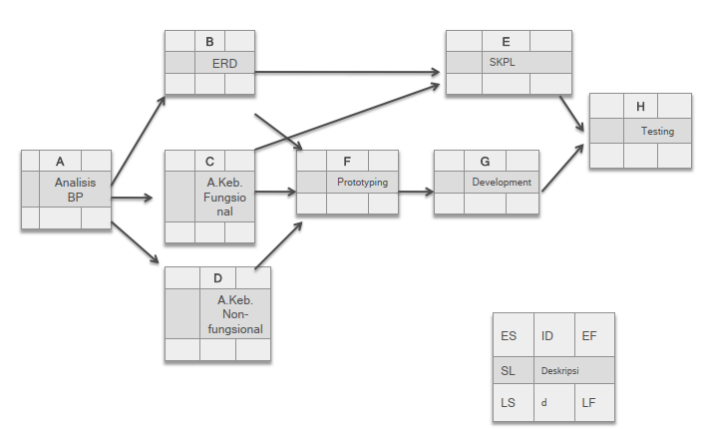
AON Network (tidak ada slack)

Slide 143
Float atau Slack
Suatu periode waktu dimana kegiatan dapat meleset tetapi tidak mempengaruhi CP (Jalur Kritis (The Critical Path)) dan tanggal pengiriman.
CP : Jalur terpanjang dalam jaringan kerja, dihitung dengan menambahkan lamanya waktu sepanjang jalur.

Slide 144
Float Bebas dan Float Total (Free Float & Total Float)
Total Float (TS) adalah waktu total float dimana kegiatan sebelumnya berpengaruh pada CP.
Jumlah waktu yang diperkenankan untuk suatu kegiatan boleh ditunda atau terlambat, tanpa mempengaruhi jadwal pelaksanaan proyek secara keseluruhan
Kegiatan-kegiatan yang memiliki nilai slack total tertentu (tidak sama dengan nol), maka pelaksanaan kegiatan tersebut dalam jalur yang bersangkutan dapat ditunda atau diperpanjang sampai batas nilai slack
Kegiatan-kegiatan yang mempunyai nilai float total sama dengan nol, berarti kegiatan tersebut dalam pelaksanaanya tidak boleh ditunda atau terlambat sama sekali.
Free Float (FS) adalah waktu float dimana kegiatan sebelumnya tidak berpengaruh pada kegiatan lainnya.
Jumlah waktu yang diperkenankan untuk suatu kegiatan boleh ditunda atau terlambat, tanpa mempengaruhi atau menyebabkan keterlambatan pada kegiatan berikutnya.

Slide 145
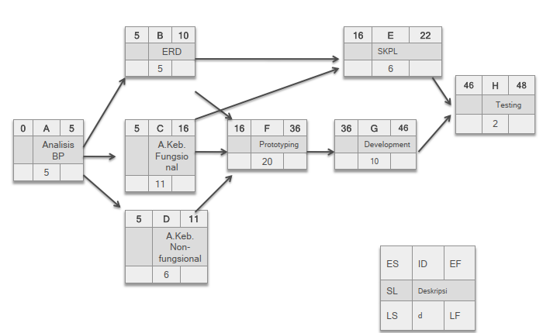
AON Network (Tidak Ada Slack)

Slide 146
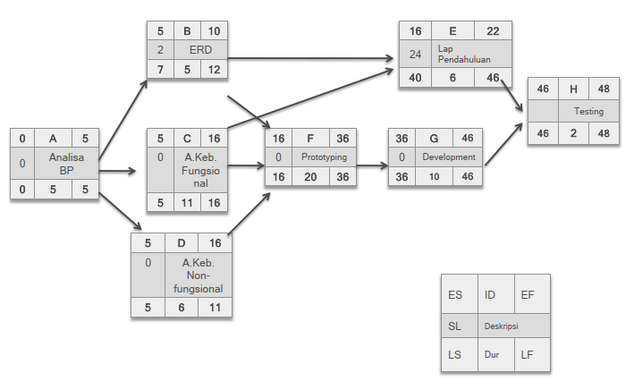
AON Network (ada slack)

Slide 147
PROJECT CHARTER

Slide 148
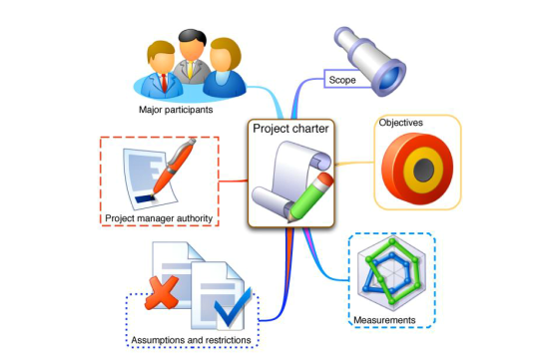
Project Charter

Slide 149
Project Charter
Project Charter adalah suatu landasan serta definisi formal bagi sebuah proyek.
Project charter berisi elemen-elemen yang unik yang hanya berlaku dalam sebuah proyek.
Elemen-elemen project charter adalah:
Nama proyek resmi;
Sponsor untuk proyek dan kontak informasi;
Manager proyek dan kontak informasi;
Goal (tujuan) proyek;
Penjelasan asal-muasal proyek;
Hasil akhir Deliverables dari fase-fase dalam proyek;
Strategi global dalam pelaksanaan proyek;
Penjadwalan proyek;
Sarana dan prasarana serta sumberdaya proyek, biaya (kasar), staff, vendors / stakeholders.

Slide 150
Project Charter
Berguna untuk:
Pendefinisian awal proyek secara jelas
Mengenali atribut-atribut suatu proyek
Identifikasi autoritas suatu proyek (sponsor, manajer, anggota utama tim kerja)
Peran kerja orang-orang utama yang terlibat dan kontak informasinya
Pondasi jalannya proyek (batasan awal dari visi dan misi proyek).

Slide 151
Project Charter
Sebuah proyek charter akan menumbuhkan:
Sense of responsibility/ tanggung jawab (manajer)
Sense of teamwork/ kerja sama (tim kerja)
Sense of ownership/ kepemilikan (sponsor)

Slide 152
Tugas
Silakan buat jadwal proyek berdasarkan WBS yang sudah dibuat merujuk pada Project Akhir yang akan dibuat, kemudian tentukan ketergantungan aktivitas pendahulunya, durasi pengerjaan proyek (hari), tanggal mulai, dan tanggal selesai
Contoh:
Buatlah diagram network (AON) lengkap beserta durasi waktunya
No.Aktivitas ProyekAktivitas
pendahulu
Durasi
(hari)
Tanggal
mulai
Tanggal
selesai

Slide 153
3) Kontrak Perkuliahan
a). Tatib Perkuliahan
b). Contact
c). Referensi

Slide 154
Tata Tertib Perkuliahan Kamis TIF6B
Masuk sesuai jadwal 7.15 WIB, Toleransi keterlambatan adalah 15 menit.
Pakaian bebas rapi berkerah, bersepatu.
Segala macam bentuk ijin ketidakhadiran diharuskan dengan alasan yang jelas
Setiap mahasiswa dilarang mencontek dalam pengerjaan tugas dan ujian, jika terjadi maka pengerjaan tugas dan ujian akan dikurangi 20% atau Gugur.
Setiap mahasiswa dilarang melakukan tindakan plagiat atas pengerjaan tugasnya, jika terjadi maka pengerjaan tugas akan dikurangi 20% atau Gugur.
Setiap mahasiswa wajib mengerjakan ujian dan tugas baik tugas mandiri ataupun berkelompok.
Wajib untuk bertutur kata yang sopan dan santun didalam kelas dan berpakaian rapih dan sopan

Slide 155
Tata Tertib Perkuliahan Jumat TIF6A
Masuk sesuai jadwal 15.15 WIB, Toleransi keterlambatan adalah 15 menit.
Pakaian bebas rapi berkerah, bersepatu.
Segala macam bentuk ijin ketidakhadiran diharuskan dengan alasan yang jelas
Setiap mahasiswa dilarang mencontek dalam pengerjaan tugas dan ujian, jika terjadi maka pengerjaan tugas dan ujian akan dikurangi 20% atau Gugur.
Setiap mahasiswa dilarang melakukan tindakan plagiat atas pengerjaan tugasnya, jika terjadi maka pengerjaan tugas akan dikurangi 20% atau Gugur.
Setiap mahasiswa wajib mengerjakan ujian dan tugas baik tugas mandiri ataupun berkelompok.
Wajib untuk bertutur kata yang sopan dan santun didalam kelas dan berpakaian rapih dan sopan

Slide 156
b) Contact

Slide 157
Contact
Bahan Kuliah : github.com/doniaft
Email : doniaft@gmail.com
WA/Telegram :
Komting PPL IF6B: Rahma Nur Laila Sari 082232916993
Komting PPL IF6A : Wahyu Akbar Wibowo 0819 1344 3901

Slide 158
c) Referensi

Slide 159
Referensi (1)
http://romisatriawahono.net
Schwalbe, K. 2006. Information Technology Project Management, Third Edition. Course Technology.
R.Duncan Wiliam, A Guide To The Project Managament Body of Knowledge PMBOK 4 [Book]. -Canada : PMBOK, 2008.
Stephen S. Bonham, IT Project Portfolio Management, ARTECH HOUSE, INC. 2005
PMI. 2008. A Guide to the Project Management Body Of Knowledge (PMBOK Guide)-Fourth Edition. Project Management Institute, Inc.
Kendall & Kendall. 2006. Analisis dan Perancangan Sistem Edisi Kelima
Jilid 1. PT. Indeks Kelompok Gramedia : Jakarta
Shelly et al. System Analysis dan Design. 2004.
Sutabri, Tata. 2005. Analisis Sistem Informasi

